Slide 1
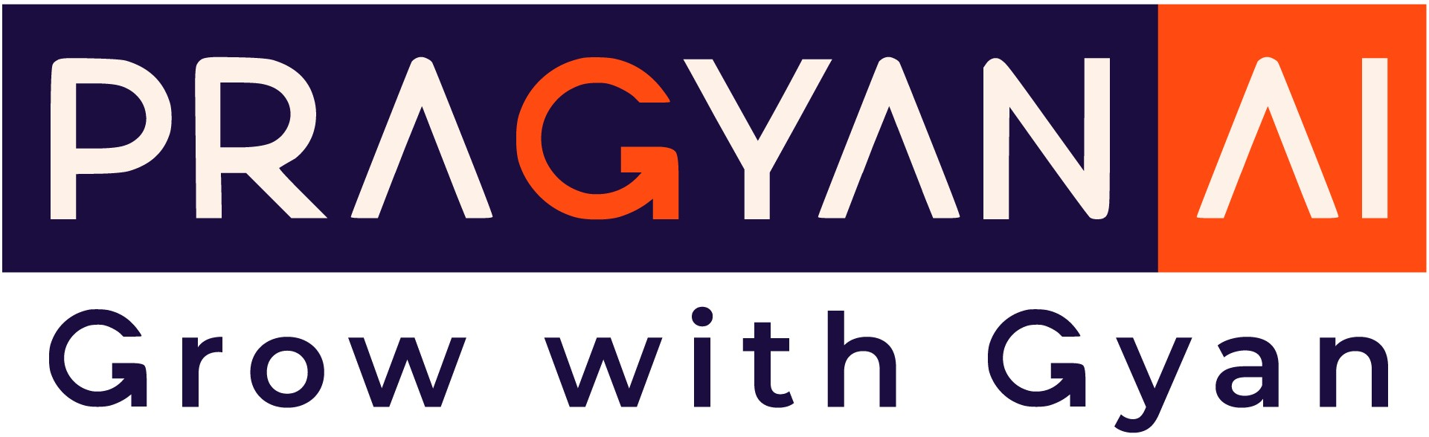

Employee Attrition and Factors Clustering
Using Machine Learning to Understand and Reduce Employee Turnover
By: Aswin.G.Kumar

Slide 2
Introduction
Employee Attrition refers to the gradual reduction of a company's workforce due to resignations, retirements, layoffs, or other reasons where employees leave and are not replaced immediately. It is often categorized into voluntary attrition (when employees leave by choice, such as for better opportunities) and involuntary attrition (when employees are let go due to performance issues, layoffs, etc.).
Impact on Businesses
Increased Costs: High attrition leads to recruitment and training expenses to replace departed employees.
Loss of Expertise: Departing employees take valuable skills, knowledge, and experience, which can affect productivity and innovation.
Lower Employee Morale: Frequent turnover can create uncertainty and dissatisfaction among remaining employees.
Reduced Customer Satisfaction: Attrition in customer-facing roles can disrupt service quality and damage client relationships.
Operational Disruption: Losing key employees can lead to delays in projects and hinder business continuity.
Reputation Risk: High turnover may indicate poor working conditions, negatively impacting the company's brand and ability to attract talent.
Understanding and managing attrition effectively is crucial to minimizing these impacts and maintaining a stable and productive workforce.

Slide 3
Objective: The goal is to cluster employees based on various factors contributing to attrition to identify patterns and insights that can help organizations reduce turnover and improve employee retention strategies.
The Employee Attrition and Factors Dataset provides valuable insights into employee behaviors and characteristics, specifically focusing on the factors influencing employee turnover (attrition). Attrition, or the rate at which employees leave a company, is a critical metric for any organization, as it can significantly impact operational efficiency, morale, and recruitment costs.
This dataset offers a collection of attributes related to the personal and professional aspects of employees, allowing organizations to analyze patterns and identify the key drivers of employee attrition. By clustering employees based on various factors, organizations can develop targeted strategies for retention, improve work environments, and optimize human resource management.
Employee attrition is a critical challenge for organizations, as it directly impacts operational efficiency, employee morale, and overall business performance. Understanding the underlying factors influencing employee turnover can help businesses design effective strategies to improve retention and enhance workplace satisfaction.

Slide 4
This project focuses on clustering employees based on factors contributing to attrition, such as demographic information, job-related attributes, compensation, work environment, and performance indicators. By grouping employees with similar characteristics, the study aims to uncover patterns and insights that can guide targeted interventions to reduce attrition rates.
Objective
The primary objective of this project is to identify clusters of employees based on shared attributes related to attrition. These clusters will help:
Pinpoint Key Drivers of attrition within each group.
Develop Tailored Strategies for employee retention.
Enhance Workforce Planning by predicting which groups are at higher risk of turnover.
This approach leverages machine learning techniques, specifically clustering algorithms, to analyze the dataset and derive actionable insights.

Slide 5
Advantages of Clustering for Attrition Analysis
Clustering in attrition analysis offers several advantages, providing valuable insights into employee behavior and helping organizations develop effective retention strategies. Here are some key benefits:
1. Identifying Attrition Patterns
Clustering helps group employees with similar characteristics or experiences, making it easier to identify patterns related to attrition.
For example, it can reveal whether certain demographics, job roles, or tenure lengths are more prone to leaving.
2. Segmenting Employees
Employees can be segmented into clusters based on factors like performance, engagement, job satisfaction, and compensation.
This allows HR teams to tailor interventions and retention strategies for each cluster.
3. Proactive Retention Strategies
Clusters highlighting high-risk employees for attrition allow organizations to act proactively by addressing specific pain points (e.g., improving work-life balance or offering career development opportunities).
4. Data-Driven Decision Making
Clustering provides actionable insights by grouping data points with similar attributes, enabling more informed HR decisions.
For example, identifying clusters of employees dissatisfied with compensation can inform salary adjustments or benefit enhancements.
By leveraging clustering techniques, organizations can gain a deeper understanding of employee dynamics, implement targeted interventions, and improve retention outcomes effectively.

Slide 6
Disadvantages of Clustering for Attrition Analysis
While clustering offers valuable insights for attrition analysis, it also has certain disadvantages and limitations that organizations should be aware of. These include:
1. Subjectivity in Feature Selection
The quality of clustering heavily depends on the features selected for analysis (e.g., demographics, job satisfaction, performance metrics).
Irrelevant or poorly chosen features can lead to misleading clusters and incorrect conclusions.
2. Complexity in Determining Optimal Clusters
Choosing the right number of clusters (e.g., using methods like the Elbow Method or Silhouette Score) can be challenging and subjective.
Incorrect clustering can result in overfitting or underfitting, reducing the model's effectiveness.
3. Overgeneralization
Clustering groups employees into generalized categories, potentially overlooking individual nuances or unique cases.
Some employees may not fit well into any cluster, leading to inaccurate insights for those cases.
By being mindful of these limitations, organizations can take steps to mitigate the risks associated with clustering and ensure its effective application in attrition analysis. Combining clustering with other methods, such as predictive modeling and qualitative insights, can provide a more holistic understanding of employee attrition.

Slide 7
Machine Learning
Machine Learning (ML) is a branch of artificial intelligence (AI) that focuses on creating systems capable of learning from data and making decisions or predictions without being explicitly programmed. It involves the use of algorithms and statistical models to identify patterns and insights from data, enabling systems to improve their performance on a specific task over time.
Types of Machine Learning
Supervised Learning: The model is trained on labeled data (e.g., predicting house prices based on features like size and location).
Unsupervised Learning: The model works with unlabeled data to identify patterns (e.g., customer segmentation).
Reinforcement Learning: The model learns through trial and error to maximize a reward (e.g., game-playing AI like AlphaGo).
Semi-supervised Learning: Combines a small amount of labeled data with a large amount of unlabeled data
Aspect | Regression | Classification | Clustering
Output | Continuous value | Discrete label | Groups(clusters)
Type | Supervised learning | Supervised learning | UnSupervised learning
Common Algorithms | Linear, Isotonic……. | Logistic…… | Kmean, DBSCAN……

Slide 8
Clustering In Machine Learning
Clustering is a type of unsupervised machine learning technique that organizes similar data points into groups, or clusters, based on their characteristics, without relying on predefined labels or categories. Unlike supervised learning, clustering focuses on identifying patterns and relationships within the data autonomously. The goal is to group data points such that those within the same cluster are more similar to each other than to those in other clusters.
Purpose:
Identifies hidden patterns in data.
Groups objects or observations based on their similarities.
Often used in exploratory data analysis.
Challenges in Clustering:
Choosing the number of clusters (e.g., kkk in K-Means).
Defining a suitable similarity measure.
Handling high-dimensional or noisy data.
Evaluating clustering quality without true labels (common metrics include silhouette score, Davies-Bouldin index, etc.).

Slide 9
Clustering In Machine Learning
Clustering in the context of machine learning is an unsupervised learning technique used to group a set of data points into clusters (or groups) based on their similarity. The goal of clustering is to organize data in such a way that:
Intra-cluster similarity (similarity within a cluster) is maximized: Data points within the same cluster are more similar to each other.
Inter-cluster dissimilarity (difference between clusters) is maximized: Data points in different clusters are as distinct as possible.
Clustering is used when the dataset does not have labeled outcomes, making it an exploratory data analysis technique. It helps identify patterns, structures, or groupings in data that may not be immediately apparent.
Applications:
Market segmentation: Grouping customers based on purchasing behavior.
Image segmentation: Dividing an image into regions with similar properties.
Anomaly detection: Identifying outliers in data.
Biological data analysis: Classifying genes, proteins, or species based on features.

Slide 10
Key Clustering Algorithms:
K-Means Clustering
Explain the concept of centroids and assigning points.
Mention its simplicity and use for well-defined clusters.
Hierarchical Clustering
Explain its structure (dendrogram).
Use case: when the number of clusters is unknown.
DBSCAN (Density-Based Spatial Clustering)
Explain how it identifies clusters based on density.
Advantage: works well for arbitrary shapes.
Gaussian Mixture Models (GMM)
Based on probabilistic models.
Suitable for overlapping clusters.

Slide 11
K-Means Clustering
K-Means Clustering is an unsupervised machine learning algorithm that groups data into kkk clusters based on their similarity. It works by assigning each data point to the nearest cluster centroid and updating the centroids iteratively until they stabilize. It's simple, efficient, and widely used for tasks like customer segmentation, image compression, and pattern recognition.
How K-Means Clustering Works
Initialization:
Choose the number of clusters kkk.
Randomly initialize kkk cluster centroids.
Assigning Points to Clusters:
Each data point is assigned to the cluster whose centroid is closest (based on a distance metric like Euclidean distance).
Updating Centroids:
The centroids are recalculated as the average position of all data points in the cluster.
Repeat:
Steps 2 and 3 are repeated until the centroids no longer change significantly or a maximum number of iterations is reached.

Slide 12
Hierarchical Clustering
Hierarchical Clustering is an unsupervised machine learning algorithm that groups data into clusters by creating a hierarchy. It builds a tree-like structure (dendrogram) to show how clusters are formed. There are two types: Agglomerative (merges small clusters into larger ones) and Divisive (splits large clusters into smaller ones). It’s useful for visualizing data relationships but can be slow for large datasets.
How Hierarchical Clustering Works
Two Approaches:
Agglomerative (Bottom-Up): Starts with each data point as its own cluster and merges the closest clusters iteratively until all points belong to one cluster.
Divisive (Top-Down): Starts with all data points in one cluster and splits them into smaller clusters recursively.
Distance Metrics:
Determines the similarity between data points (e.g., Euclidean, Manhattan distance).
Linkage Criteria:
Defines how the distance between clusters is calculated:
Single Linkage: Minimum distance between points in two clusters.
Complete Linkage: Maximum distance between points in two clusters.
Average Linkage: Average distance between points in two clusters.
Ward’s Method: Minimizes variance within clusters.

Slide 13
Evaluation Metrics:
Evaluation Metrics:
Silhouette Score: Measures how similar data points in a cluster are to their own cluster compared to others.
Calinski_harabasz_score: The Calinski-Harabasz score is commonly used to evaluate clustering algorithms like K-Means, particularly when choosing the optimal number of clusters.
Elbow Method: Determines the optimal number of clusters in K-Means by plotting the sum of squared distances.
Davies-Bouldin Index: Considers cluster compactness and separation.
Adjusted Rand Index (ARI): Measures the similarity between predicted and true clusters (if available).
ongoing Employee Attrition and Factors Clustering project, clustering could help us discover patterns in employee data that influence attrition, such as work environment, performance, or demographic factors.

Slide 14
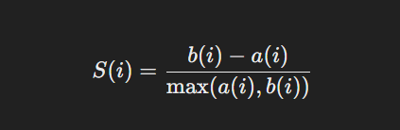
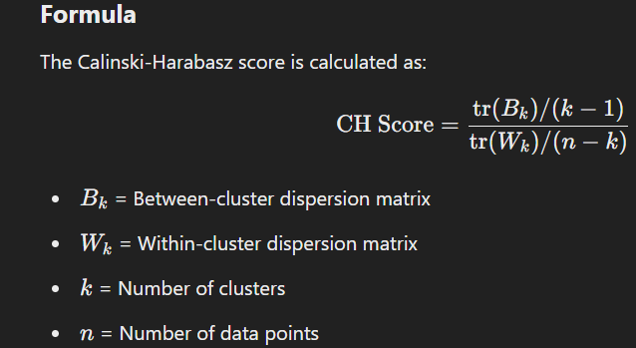
Silhouette Score:
The Silhouette Score is a metric used to evaluate the quality of clustering in unsupervised learning. It measures how similar data points are to their own cluster (cohesion) compared to other clusters (separation).
Formula
For a data point i:
a(i): Average distance between i and other points in the same cluster
.b(i): Average distance between i and points in the nearest cluster.
Calinski_harabasz_score
The Calinski-Harabasz Score (also known as the Variance Ratio Criterion) is a metric used to evaluate the quality of clustering. It measures how well-separated and dense the clusters are by comparing the ratio of the sum of between-cluster dispersion to within-cluster dispersion.

Slide 15
Conclusion
Summary of Findings
Key Insights: Clustering has helped identify distinct patterns and factors contributing to employee attrition, such as job satisfaction, performance, and tenure.
Actionable Results: By segmenting employees based on these factors, we can better understand why certain employees are more likely to leave and create strategies to address their concerns.
Implications for Employee Retention
Targeted Retention Strategies: Clustering allows for the creation of customized retention programs that focus on specific groups, addressing their unique needs to reduce turnover.
Resource Optimization: By identifying high-risk groups, organizations can allocate resources more efficiently, prioritizing interventions where they are most needed.
Clustering’s Role in Addressing Attrition
Clustering allows businesses to spot trends and take a proactive approach in managing attrition, reducing turnover rates, and improving employee satisfaction.

